Slide 1

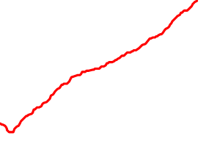
TRANSFER FUNCTIONS
POLES & ZEROS -> WHAT DO THEY MEAN?
Transfer Function Notation:
z₁ through z_{N} are the “zeros,” or the complex frequencies at which the numerator becomes zero (the transfer function goes to zero)...
p₁ through p_{M} are the “poles,” or the complex frequencies at which the denominator becomes zero (the transfer function goes to infinity)...
• The “order” of the system = N + M
• A zero alone would make the output amplitude of a circuit increase forever with increasing frequency. In real circuits, one cannot have a zero without a pole to “cancel” it out at some frequency.
1

Slide 2
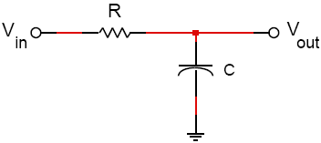
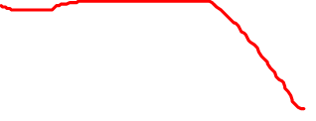
TRANSFER FUNCTIONS
SIMPLE FILTERS
• The cutoff (or 3dB) frequency is the point at which the response is 3 dB lower than in the passband ( ~ 0.707 times the passband amplitude).
HERE IS A GOOD IDEA TO GET A SENSE FOR CIRCUIT BEHAVIOR: Look at the circuit first before doing any math! The capacitors are all infinite impedance for DC and their impedance decreases toward zero as the frequency increases.
FIRST-ORDER RC LOW-PASS FILTER:
2

Slide 3
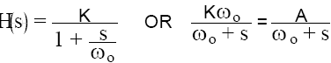
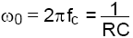
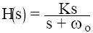

TRANSFER FUNCTIONS
The general form is
where K is the gain for low frequencies and A = Kω₀
• The pole is at S = -ω₀
• The “cutoff” frequency is at
FIRST-ORDER RC HIGH-PASS FILTER:
The general form is
where K is the gain for high frequencies
• The pole is at S = -ω₀ and the zero is at S = 0
• The cutoff frequency is the same as for the low-pass filter.
3

Slide 4
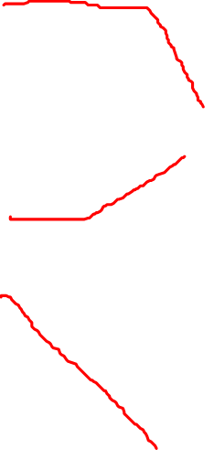
BODE PLOTS
THE BASIC IDEA: The point is to be able to draw a "quick" sketch of a transfer function of a circuit.
Assume: you have an equation for the transfer function.
ADD up the individual responses of all of the poles and zeros of the transfer function.
They each affect the frequency response “only” after they take effect at their respective “break” frequencies....
• a pole makes the amplitude fall with frequency by 20 dB /decade and “has no effect” before its break frequency
• a zero makes the amplitude rise with frequency by 20 dB/decade and “has no effect” before its break frequency
• a pole causes the phase to fall from 0° to -90° over two decades of frequency starting one decade before the break frequency -> the phase is -45° at its break frequency
• a zero causes the phase to rise from 0° to +90° over two decades of frequency starting one decade before the break frequency -> the phase is +45° at its break frequency
• the effects of poles or zeros at “zero” frequency have already “maxed out” by the time you start your plot (i.e. phase is -90° for a pole at zero frequency, and +90° for a zero at zero frequency)
4

